Slide 1













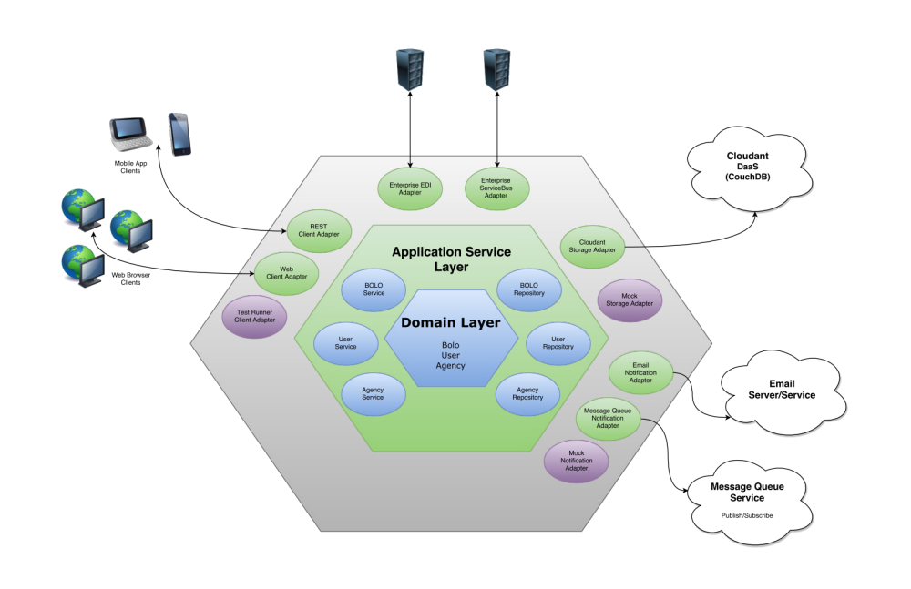
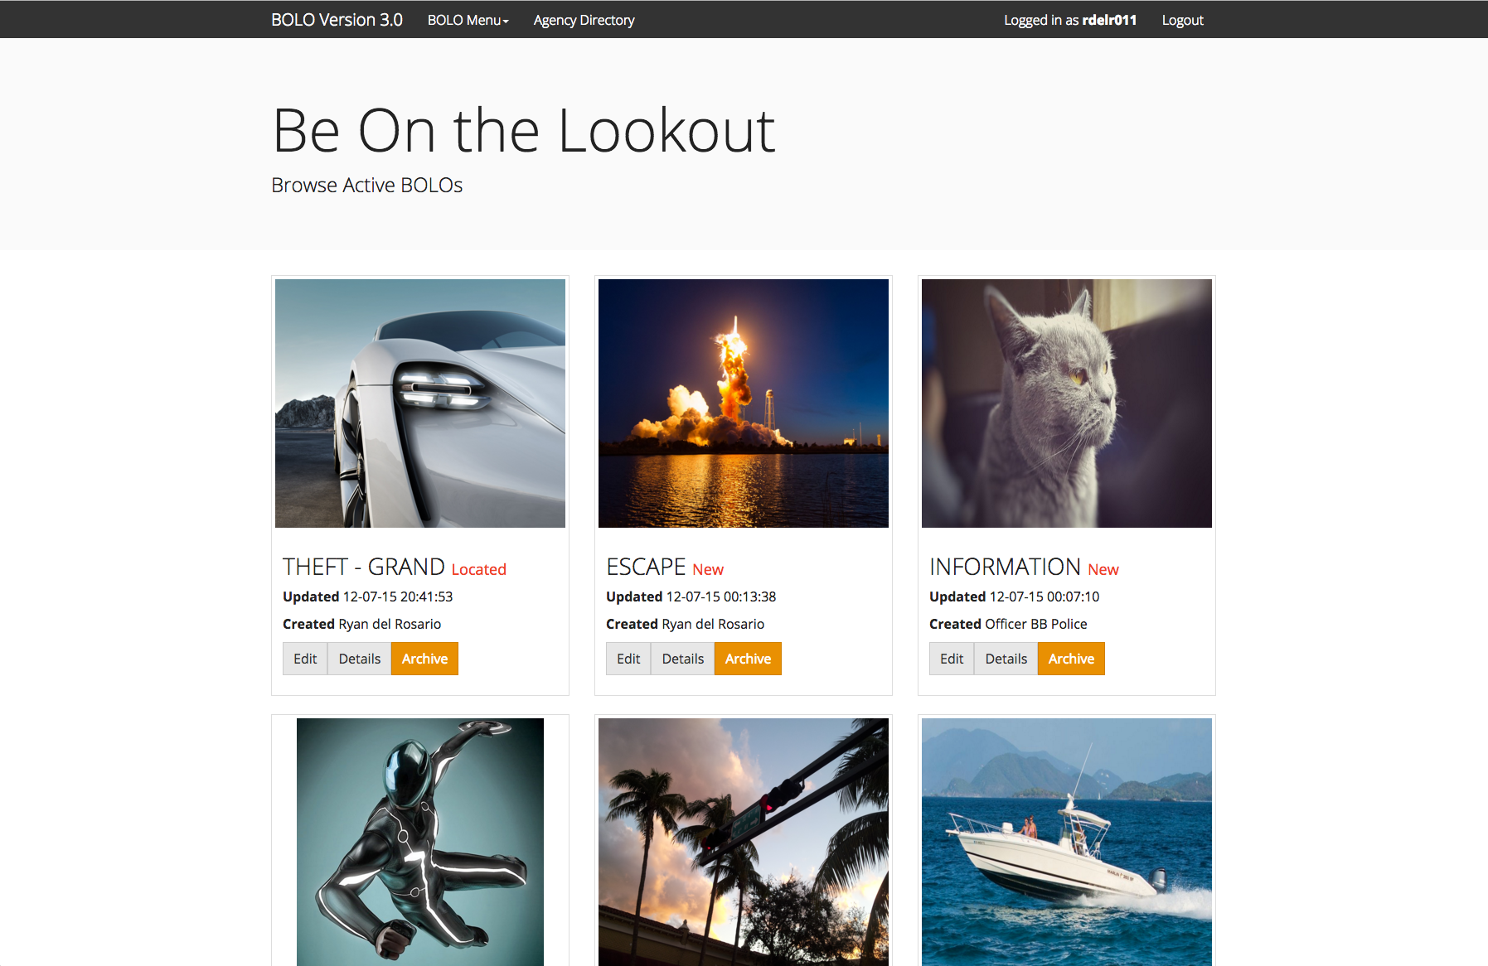
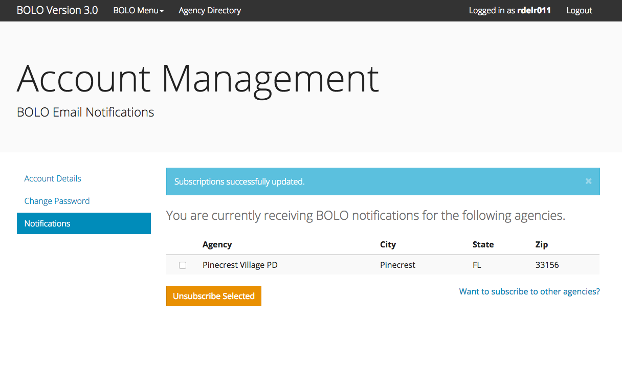
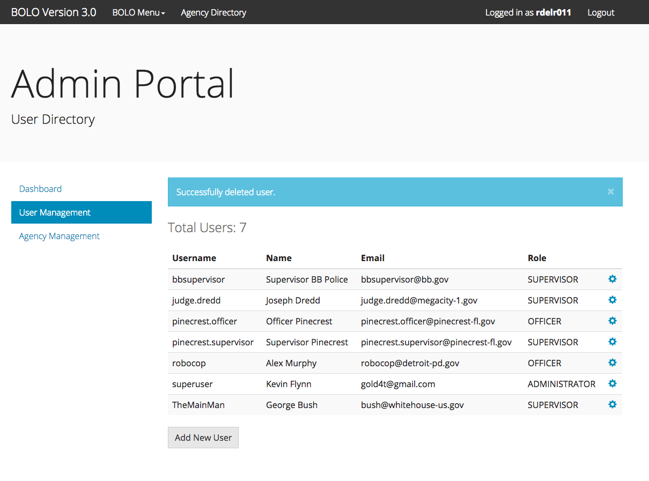
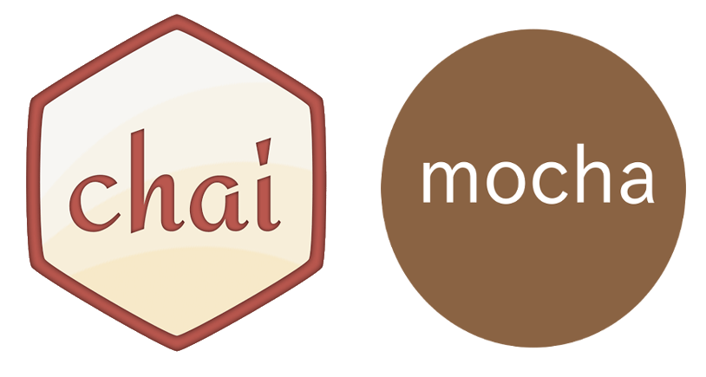

School of Computing & Information Sciences
Senior Project, 2015, Fall
BOLO Version 3.0
Student: Rodney Sanchez, Florida International University
Mentor: Robert Loredo, IBM
Instructor: Masoud Sadjadi, Florida International University
Problem
Current System
Requirements
The creation and distribution of information which can help law enforcement officers and agencies is complex and difficult to manage. The process can sometimes require varying levels of approvals, validations, and transfers before being distributed out. The sometimes lengthy and complex process can also lead to errors and delays before the information is distributed. During distribution it is also hard to determine the scope of dissemination of the information: who needs it and what method of distribution(s) to use.
The current system employs a variety of strategies for creating and disseminating BOLO (Be On the Lookout) information to agencies and officers. Some of these strategies include alerts over police radio which may or may not be heard, computer aided dispatch software which requires that officers are equipped with specific hardware, and finally paper documents created in a word processor and printed out. While these systems currently work, a more accessible solution is desired.
The main requirements for this version were to port over features from previous implementations of the system while increasing security and scalability. The BOLO system seeks to streamline the process, increase dissemination, and remove errors due to human error. In order to accomplish these goals the application must allow users to easily create BOLOs from many types of devices and various situational environments.
System Design
Object Design
Implementation
A micro services architectural design was initially proposed for this project but in order to mitigate risks (complexity vs. skills) a hexagonal architecture was chosen. A hexagonal architecture (sometimes called ports and adapters) should theoretically allow the design to evolve the ports and adapters into well defined micro services.
During the design of the initial system objects the team chose to use ideas from the Domain Driven Design approach by Eric Evans. The idea of a domain model fits nicely with the hexagonal architecture that was chosen for this project. The main Agency, User, and Bolo entities make up the domain layer with concrete Cloudant repository objects handling persistence of those entities.
Following from the requirements the goal of this version is to implement the BOLO system with security and scalability in mind. This version started porting the application from a PHP/WordPress based system to a system built from the ground up using NodeJS with ExpressJS as the framework handling server-side requirements. HTML5, CSS3, and Javascript are utilized for client-side requirements. Finally IBM Bluemix with Cloudfoundary handle infrastructure needs.
The requirements for the system include the need for persistence and notifications. For persistence the project uses IBM’s Cloudant Database Service which provides a CouchDB NoSQL interface with some extra features such as querying and geospatial indexing. For notifications the project uses the SendGrid service to handle emailing of notifications to subscribed system
Verification
Screenshots
In order to verify the behavior of the application the team employed practices from Kent Beck’s Extreme Programming such as test-first development and pair programming. Unit tests are written for all system core classes and modules. The team uses the Mocha testing framework as a test runner with the Chai assertion library for writing tests. Integration tests were also written using the same tools. For acceptance tests, Selenium IDE is used to automate front-end browser interactions.
Summary
BOLO Flier Creator v3.0 builds on top of previous semester iterations which explored feature sets that would be useful to the problem domain. This iteration (version 3.0) builds on top of the lessons learned and re-implements the requirements in an environment that is believed to be more robust, secure, and easier to extend. All components ranging from the infrastructure to client-side implementations were chosen to meet the requirements of a secure and scalable production system.
Acknowledgement
The material presented in this poster is based upon the work supported by Vilage of Pinecrest Police Department, Major Jason Cohen, and Captain Samuel Ceballos. I am thankful for the help that I received from my group member Ryan del Rosario. Extra thanks go to our product manager Juan Caraballo, our technical mentor Robert Loredo, and finally our instructor Masoud Sadjadi.

